Slide 1
Older Adults With Cognitive and/or Physical Impairments Can Benefit From Immersive Virtual Reality Experiences: A Feasibility Study
Frontiers in Medicine 2019
中科院医学3区

Slide 2
Introduction
1. Nearly 400,000 Canadians aged 65 years and older and 30% of Canadians 85 years and older live in long-term care (LTC) residences or assisted living housing.
2. Social isolation and loneliness can accelerate the progression of chronic conditions, lead to depression, anxiety, aggressive behavior, and increase the risk of dementia.
3. Very few studies have empirically examined the feasibility of introducing immersive VR in rehab or long-term care settings.
4. There have been no empirical studies that have formalized and quantified the feasibility and effectiveness
of immersive VR (viewed through a HMD) in an older adult population with cognitive and/ or physical impairments.

Slide 3
Method
Participants
(1) Eligibility criteria
(a) adults over 18 years old.
(b) could communicate in English.
(c) were able to consent to participate in the study.
(2) Exclusion criteria
(a) vision impairment at a level that would make it impossible for them to see the VR films,.
(b) chronic neck pain/injury.

Slide 4
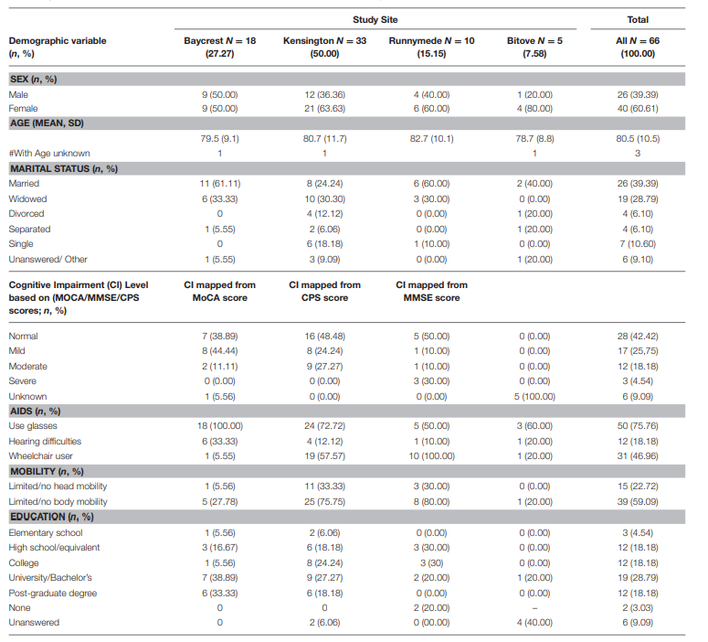

Slide 5
Method
Participants
(3) 20% of participants were accompanied by one caregiver and the remaining 80% of participants did not have caregivers with them.
2. VR Apparatus
(1) Samsung S7 smartphone to view the VR films.
(2) Samsung VR HMD that housed the smartphone/viewing screen and restricted the view of the real world.

Slide 6
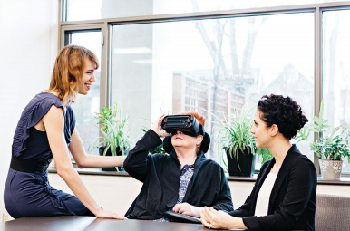
Method
2. VR Apparatus
(3) Sennheiser HD 221 headphones.

Slide 7
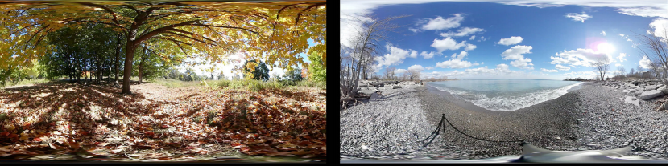
Method
3. VR
(1) 5 scenes (45s to 3min each) were presented, resulting
in a VR experience lasting 6 min in total.
(2) Rocky shore, waves, foliage, forest, ice water, glacier.

Slide 8
Method
4. Procedure
(1) 3 participants was in their rooms, 31 participants received the intervention while seated in their own wheelchair, 32 participants received the intervention while seated on a dedicated swivel chair.
(2) The participant could watch the entire VR-experience repeatedly until a maximum of 20 min.

Slide 9
Method
5. Measures
(1) State-Trait Anxiety Inventory (STAI).
(2) Music in Dementia Assessment Scales (MiDAS) questionnaire.
(3) A custom-developed Likert-scale questionnaire consisting of several open-ended questions.

Slide 10
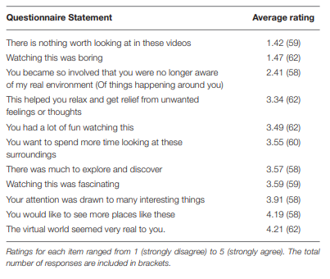
Results
1. Comfort, Tolerability, and Side-Effects of VR:
(1) Participants showed strong disagreement for questions 1 and 2.

Slide 11
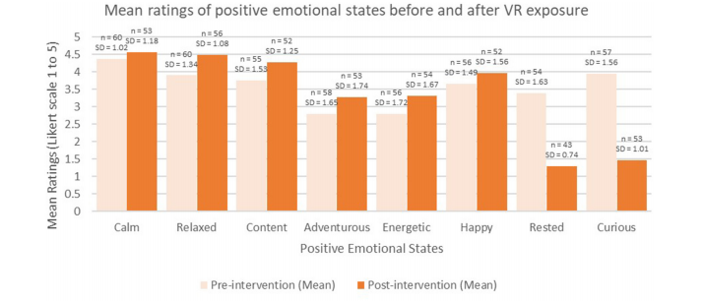
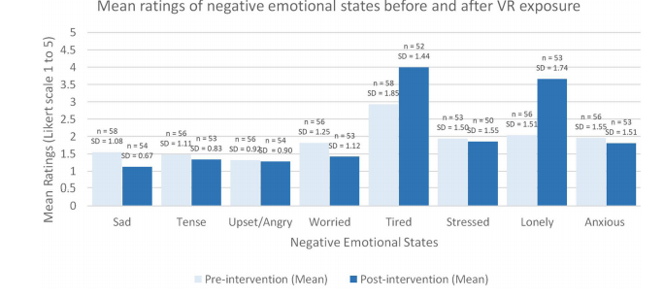
Results
2. Enjoyment of VR:
(1) In terms of the positive emotions, all but two items increased (“rested” and “curious” decreased) and none of the negative items apart from two items increased (“lonely” and
“tired” increased).

Slide 12
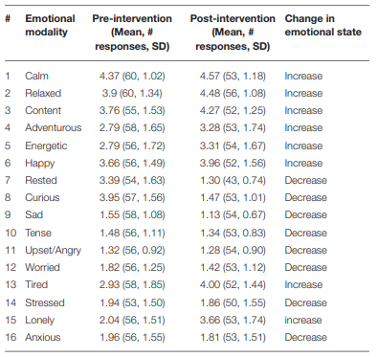

Slide 13
Results
2. Enjoyment of VR:
(2) Half of all participants (51%) indicated that the VR experience helped them gain relief from unwanted feelings or thoughts.
(3) Most participants (76%) expressed a desire to try VR again and 71% indicated that they would recommend the VR experience to a friend.

Slide 14
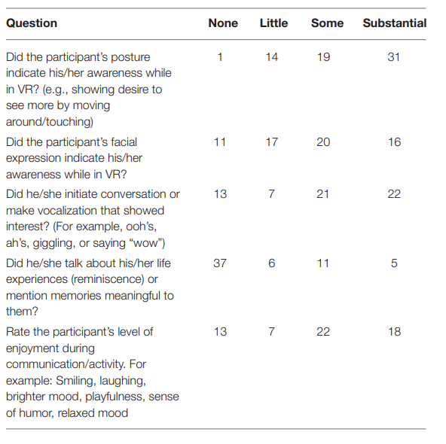

Slide 15
Discussion and Conclusion
1. On average, participants experienced increases in levels of positive emotions (such as feeling relaxed, and content) and decreases in levels of negative emotions.
2. In over 50% of participants, the research team observed increases in awareness, changes in posture, facial expression, and movement while in VR.
3. Limitations: control group or control condition.

